Slide 1

The Sun: Friend or Foe?
SunSafe in the Middle School Years
Notes:
Introduce the topic of sun safety
Use slides 2-4 to describe UVA and UVB. Before slide 5, ask students if they can think of any other way to get a dose of UV rays. The answer would be tanning lights or booths.
What Causes Sunburn and Skin Damage?
There are two kinds of ultraviolet rays that reach the earth's surface: ultraviolet A (UVA) and ultraviolet B (UVB). UVB rays cause your skin to show the signs of sunburn, but most sunscreens protect against them. These rays also are partially screened out by the ozone layer, an invisible shield that protects us from the sun. But over the years the ozone layer has become thinner, so we're getting more exposure.

Slide 2
Overview
How UVA and UVB rays damage the skin
Why protect yourself from the sun’s UV rays
  Wrinkles
  Age Spots
  Skin Cancer
  Cataracts
How to protect yourself from the sun’s UV rays

Slide 3
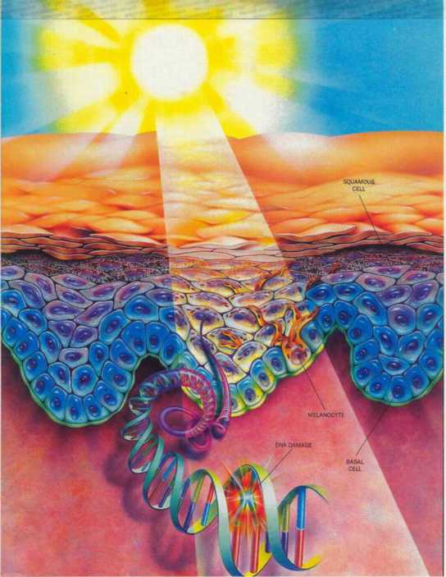
How Do UVA and UVB Rays Damage the Skin?
UVA and UVB rays make it through our atmosphere
All UV rays damage skin increasing the risk of skin cancer.
UVB rays cause sunburns.
UVA rays go deeper in the skin and cause wrinkles.
Notes:
What Causes Sunburn and Skin Damage?
There are two kinds of ultraviolet rays that reach the earth's surface: ultraviolet A (UVA) and ultraviolet B (UVB). UVB rays cause your skin to show the signs of sunburn, but most sunscreens protect against them. These rays also are partially screened out by the ozone layer, an invisible shield that protects us from the sun. But over the years the ozone layer has become thinner, so we're getting more exposure.
UVA rays don't burn your skin, but they do contribute the most damage. They penetrate your skin more deeply and affect the cells on a molecular level. That's why it's important to look for a sunscreen that will protect you from both UVA and UVB rays. UVA damage results not only in wrinkles and sagging skin, but also can cause skin cancer. And UVA intensifies with altitude, so it's particularly important to protect yourself when skiing or mountain climbing.

Slide 4
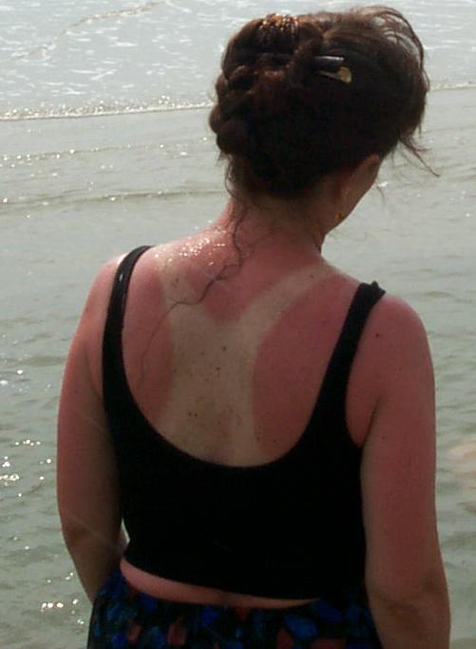
UVB Rays Cause the Skin to Burn
UVB rays cause your skin to show the signs of sunburn.
Most sunscreens protect against UVB rays.
The ozone layer also screens out UVB rays. But over the years the ozone layer has become thinner, so we're getting more exposure.
Notes:
These rays also are partially screened out by the ozone layer, an invisible shield that protects us from the sun. But over the years the ozone layer has become thinner, so we're getting more exposure.

Slide 5
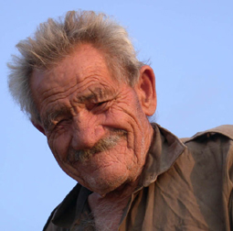
UVA Rays Cause the Skin to Wrinkle
The sun’s UVA rays damage the skin deep down, causing wrinkles!
Even though this man might not have had sunburns, his skin still shows the damage from years of exposure to these damaging UVA rays.

Slide 6
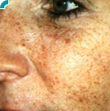
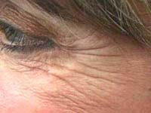
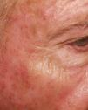
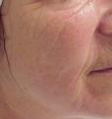
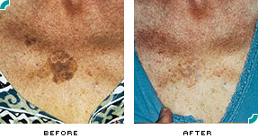
Why Protect Your Skin from UV Rays: Wrinkles and Age Spots

Slide 7
Aged Skin
Young Skin
Chronologically Aged Skin
Sun Aged Skin
Notes:
At birth we are given a flexible, but tough, protective covering. The skin color is unblemished and wrinkle free. It has a smooth texture and a good elastic tone. The surface is covered with fine hair.
Chronologic Aged Skin.
With age, all parts of the skin diminish in size and function. The skin becomes thinner, drier, and more fragile. Pigment cells are less active so that the skin tans less easily. Hair becomes finer, thinner, and gray. Despite these changes, "old" skin functions remarkably well, and no one has died of "skin failure.“
Sun Aged Skin.
Sunlight injures the skin, particularly the epidermis. The cumulative effects of sun exposure are wrinkling, blotchy pigmentation and roughness. Sun damaged skin also becomes less flexible and is more easily bruised. Sun damage is the major cause of skin cancer.

Slide 8
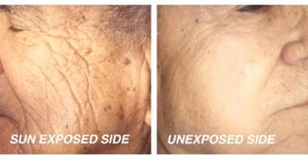
Sun Aged Skin
Notes:
This shows the long-term effects of the sun. The pictures show two sides of a truck driver's face. One side was continually exposed to the sun five days a week for many years. The smooth side shows the effects of natural aging without regular sun exposure.

Slide 9


Sun Aged Skin
Photo from the 1960s
Photo from mid 1980s
Notes:
Actress Brigitte Bardot offers an example of the long-term effects of sun exposure. This French actress starred in many films in the 1960's. The photo on the right from the mid-1980's shows the wrinkling from sun exposure that many mistakenly assume is a natural part of aging. Unlike many American actresses, Bardot has opted not to undergo face-lifts and other facial rejuvenating treatments that are currently available in the office of a dermatologist. Preventive medicine in the form of sun protection and avoidance of tanning is especially important.

Slide 10

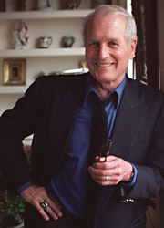



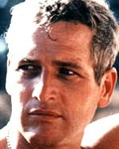
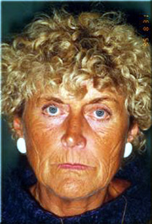

Sun Aged Skin
Tanned to wrinkled
Did not tan and look good
It makes such a difference, the people on the left tanned, they really did not age well.

Slide 11


Extreme (Skin) Makeover
Before
After
With lots of tanning both in booths and on the beach
WITHOUT SUNSCREEN.. Nicole would look like…

Slide 12
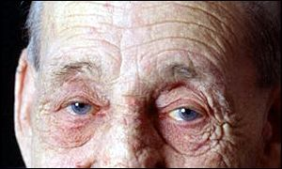
“..A tan is the skin’s response to an injury and every time you tan you accumulate damage to the skin, as well as accelerate the aging process and increase your risk for skin cancer.”
- Dr. Sekula-Gibbs

Slide 13
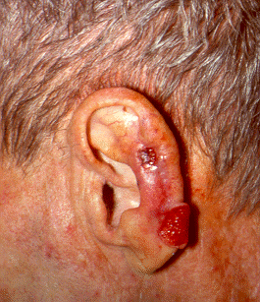
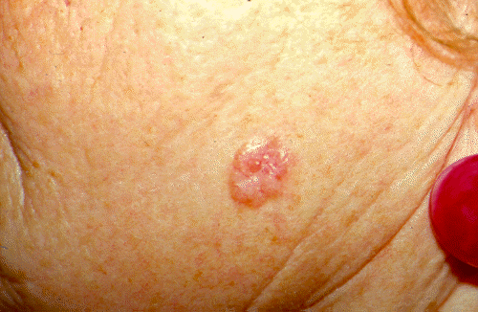
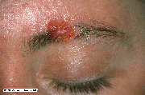
Why Protect Your Skin from UV Rays: Skin Cancer
Most skin cancer is caused by excessive UV exposure.
Skin cancer on the eyebrow of a college student

Slide 14


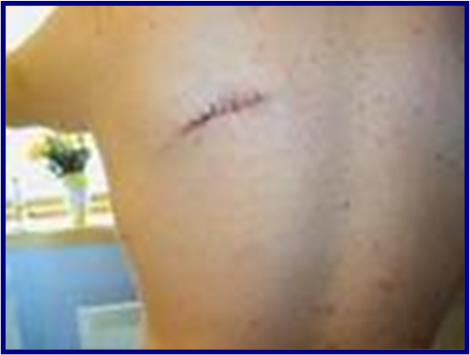


Melanoma
Irregular moles and spots can be a dangerous form of skin cancer called melanoma.
While a deadly form of skin cancer, melanoma can be cured if caught early, by having the cancerous lesion removed.
Asymmetry
Border Irregularity
Color Variation
Diameter

Slide 15

What is Wrong With This Picture?
What is he missing?
Skin cancer, even when found early, can have devastating effects on your body…
This man had skin cancer on his ear that had spread.

Slide 16
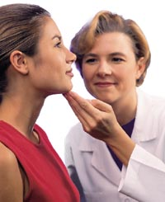
If you have questions about moles, or anything else related to skin, hair, or nails…
Contact your primary care doctor or a dermatologist
Skin Screenings and Questions

Slide 17
Your Skin Phototype
Skin Type
Sunburn Tendency
Tan Tendency
Skin, Hair, and Eye Color
I
I always get a sunburn.
I never get a tan.
white skin, freckles, blond or red hair, blue or green eyes
II
I usually get a sunburn.
I sometimes get a tan.
white skin, blond hair, blue or green eyes
III
I seldom get a sunburn.
I usually get a tan.
white skin, usually dark hair, and brown eyes
IV-VI
I never get a sunburn.
I always get a dark tan.
brown to dark skin/ brown or black hair/ brown eyes
Notes:
Your risk of developing skin cancer, among other factors, highly depends on your skin type.
In 1975, Fitzpatrick, a respected dermatologist created a standard for classifying individuals according to their skin color and burning and tanning responses to sun light exposure.
Basically, a low number means a higher risk. However, there are people with skin type 3 who develop skin cancer and even people with naturally dark skin can also develop skin cancer.

Slide 18
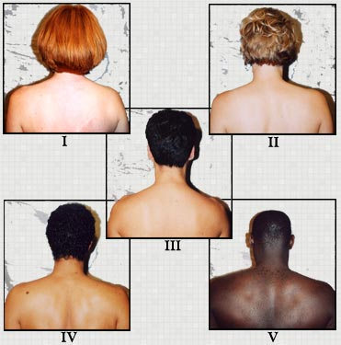
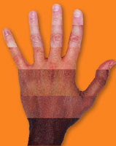
Your Skin Phototype
Notes:
Your risk of developing skin cancer, among other factors, highly depends on your skin type.
In 1975, Fitzpatrick, a respected dermatologist created a standard for classifying individuals according to their skin color and burning and tanning responses to sun light exposure.
Basically a low number means a higher risk. However, there are people with skin type 3 who develop skin cancer and even people with naturally dark skin can also develop skin cancer.

Slide 19
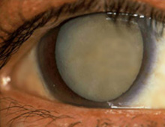
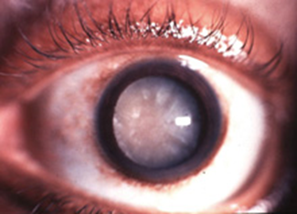
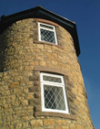
Why Protect Your Skin from UV Rays: Cataracts
Cataracts are the leading cause of loss of sight.
Cataracts make everything look blurry.
Cataracts are caused by the same damaging UVA/UVB rays.

Slide 20
How to Protect Your Skin from UVA/UVB Rays
Cover up
Long pants and shirts
Wide-brimmed hats
Sunglasses that have UVA/UVB protection
Seek Shade
Especially during times of a high UV index
Wear Sunscreen
Use a broad-spectrum, water-resistant sunscreen
SPF of 30+
Reapply at least every 2 hours
Do Not Use Tanning Beds
No one under 18 years old is permitted to use a tanning bed in NH or VT.

Slide 21
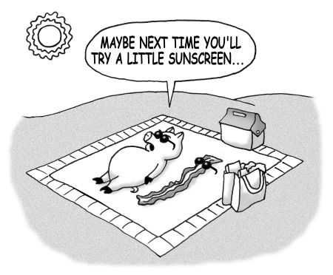
Notes:
This is supposed to be a fun joke ….don’t fry your skin.

Slide 22
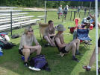
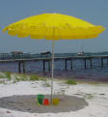
Seek Shade
Have fun in the sun!
Have fun in the shade!
In between swimming and playing, stay in the shade.
Give your skin a break!

Slide 23



Cover Up
Long Pants/Shirts
Sunglasses
Wide-brimmed hats

Slide 24
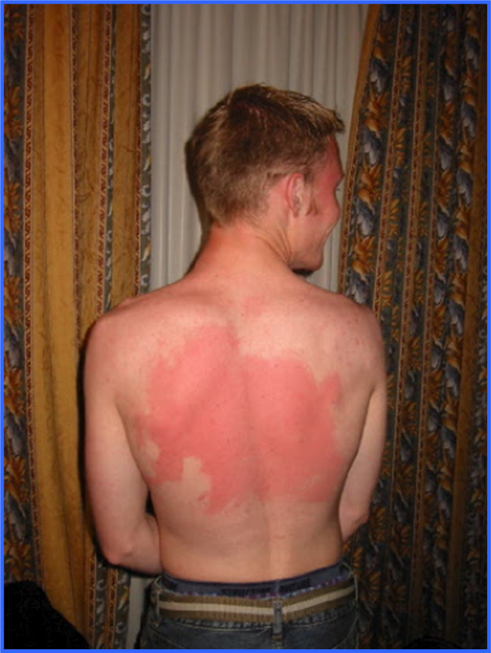
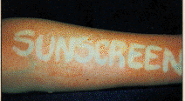
Wear Sunscreen
If you can’t reach your back, ask a friend to help you apply sunscreen.
Use a broad-spectrum, water-resistant sunscreen with SPF 30+

Slide 25
Do Not Use Tanning Beds
Tanning Bed Light is on the List of Known Carcinogens
Carcinogen = Known cancer-causing agent.
Studies have shown exposure to solar radiation is related to skin cancer and use of sun lamps or sun beds is associated with skin and eye cancer.
Notes:
The review panel unanimously approved saying human studies have shown exposure to solar radiation is related to skin cancer and use of sun lamps or sun beds is associated with skin and eye cancer.

Slide 26
So, is the Sun Your Friend or Foe?
…It’s both!
But remember to take care of yourself when spending time in the sun.
Limit your exposure and protect yourself when you are out.
You can still have fun outdoors while lowering your chance of damaging your skin and risking your health!

Slide 27
Be Sun Safe!

